Slide 1
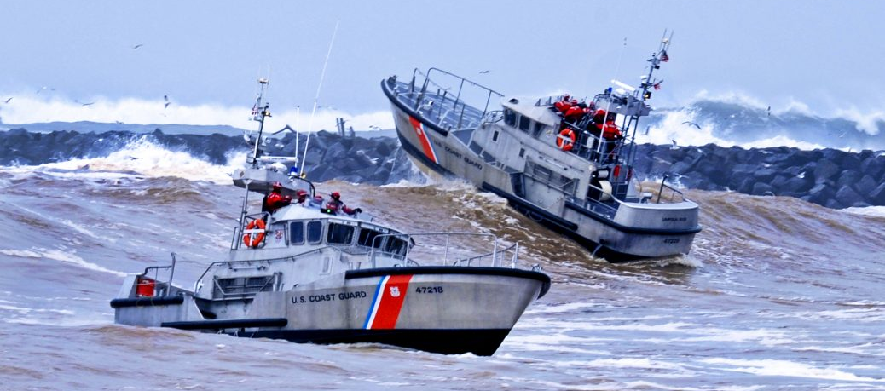

Core Leader Functions
Notes:
Core Leader Functions
The Core Leader Functions were developed to reinforce a leader’s commitment to sailors, families and overall command psychological health. The following are action elements for leaders to use to manage an environment conducive to dealing with operational stress and to develop resilience – strengthen, mitigate, identify, treat and reintegrate.

Slide 2
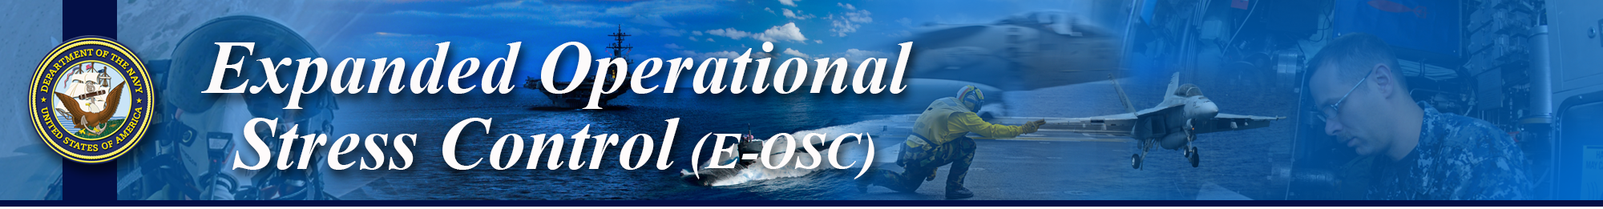
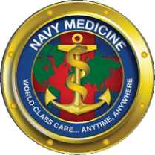
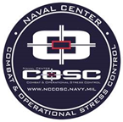
Learning Objectives
Coast Guard Operational
Stress Control (CG -0SC )
IDENTIFY leadership responsibilities
DISCUSS the Core Leader Key Components and EXPLAIN their purpose
IDENTIFY and DISCUSS the Core Leader Functions of strengthen, mitigate, identify, treat, & reintegrate
Notes:
Learning Objectives
IDENTIFY leadership responsibilities
DISCUSS the Core Leader Key Components and EXPLAIN their purpose
IDENTIFY and DISCUSS the Core Leader Functions of strengthen, mitigate, identify, treat, & reintegrate

Slide 3
Leadership Responsibilities
Coast Guard Operational
Stress Control (CG -0SC )
Create and preserve a ready force:
  Includes addressing and supporting physical, mental, social, & spiritual health in our service members
Promote long-term health & well-being:
  Actively foster resilience
  Prevent stress problems as much as possible
  Recognize when stress problems have occurred
  Eliminate the stigma associated with getting needed help
Notes:
Leadership Responsibilities
Discussion Questions:
-What are some characteristics of effective leaders?
-What leadership qualities do you have?
Leaders at all levels are responsible for preserving the psychological health of their Marines, Sailors, and family members, just as they are responsible for preserving their physical health. This responsibility applies to every link in every chain of command from fire team leaders and work center supervisors to combatant commanders and commanding officers.
To promote psychological health in their Marines and Sailors, leaders must actively foster resilience, prevent stress problems as much as possible, recognize when stress problems have occurred, and eliminate the stigma associated with getting needed help.
Actively foster resilience
Prevent stress problems as much as possible
Recognize when stress problems have occurred
Eliminate the stigma associated with getting needed help

Slide 4
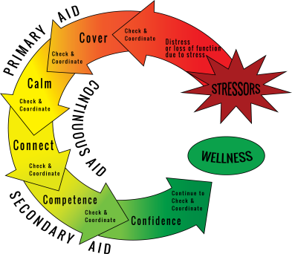
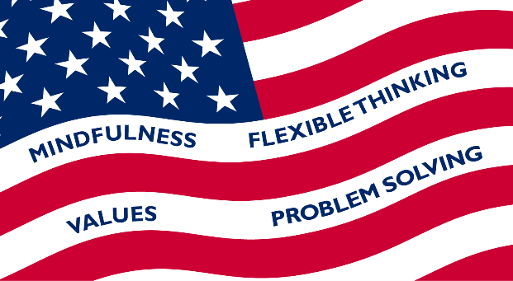
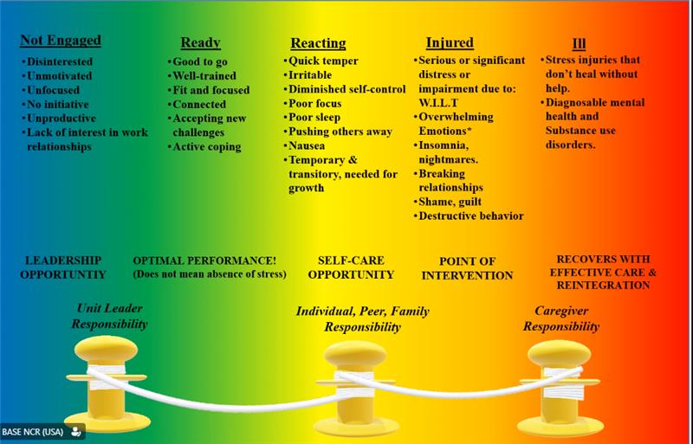
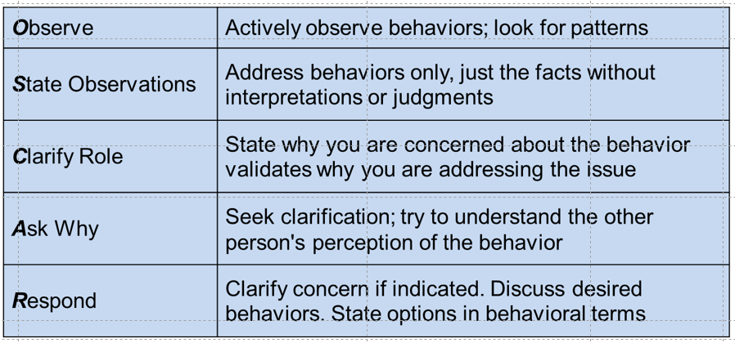
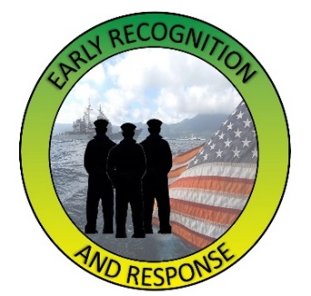

Core Leader Key Components
Coast Guard Operational
Stress Control (CG -0SC )
Operational
Stress First Aid
Resilience
Stress Continuum
Model
OSCAR
Buddy-Care &
Unit Assessment
Total Force Wellness
Notes:
Core Leader Key Components
Resilience is one’s capacity to adapt successfully and function competently to life’s challenges, adversity, stress, and trauma. Evidence-based individual resilience skills that are associated with building and preserving resilience are: optimism, flexible thinking, self-care, and positive coping & problem solving.
The Stress Continuum Model is a spectrum of stress responses categorized in four zones identifying stress responses: Green “Ready” zone, Yellow “Reacting” zone, Orange “Injury” zone and Red “Illness” zone. It is a tool and is a common language that allows us to identify, engage and intervene when stress reactions or injuries are present.
Combat & Operational Stress First Aid (COSFA) is a flexible multi-step process for the timely assessment and pre-clinical care of psychological stress injuries in individuals or units with the goals to preserve life, prevent further harm and promote recovery. The action steps of COSFA are - check, coordinate, cover, calm, connect, competence and confidence.
OSCAR is how you ask, care, and decide if escort is needed. When talking to an individual about their possible Orange Zone Indicators, a common obstacle to accurate assessment is their almost reflexive denial of experiencing any stressors, distress, or changes in functioning. A tool used is called “OSCAR” communication:
Observe: Actively observe behaviors; look for patterns
State Observations: All attention to the behaviors; just the facts without interpretations or judgments
Clarify Role: State why you are concerned about the behavior. Validates why you are addressing the issue
Ask Why: Seek clarification; try to understand the other person's perception of their behaviors.
Respond: Clarify concern(s) if indicated. Discuss desired behaviors. State options in behavioral terms.
Buddy Care and Unit Assessment are Command Resilience Team (CRT) intervention tools used to assess individuals and or units during times of stress.
Buddy Care uses peers who are trained to provide social and emotional assistance and to create a safe and trusting environment. It is observing, identifying and intervening with peers when stress symptoms become apparent.
A Unit Assessment is used as a foundation for providing actionable recommendations for leaders to a unit that has been exposed to one or more stress injuries (Wear & Tear, Inner Conflict, Loss, & Life Threat).
A leadership tool used to assess the overall functioning of a unit.
Total Force Wellness Assessment is a web based resource for Commands to use in conjunction with Coast Guard Operational Stress Control (CG-OSC). This tool was developed to provide a confidential real- time “snapshot’ of the stress level for command personnel. The assessment collects subjective information based on the Stress Continuum and creates a “dashboard” for command leadership.
Total Force Wellness: is an resource for commands to use in conjunction with wellness programs such as the Caregiver Occupational Stress Control (CgOSC) Program. This tool was developed to provide a confidential real- time “snapshot’ of the stress level for command personnel. The Stress-o-Meter collects subjective information based on the Stress Continuum and creates a “dashboard” for command leadership. This “dashboard” illustrates the “temperature” of the command, directorate, or department to assist leaders with understanding staff stress levels.

Slide 5
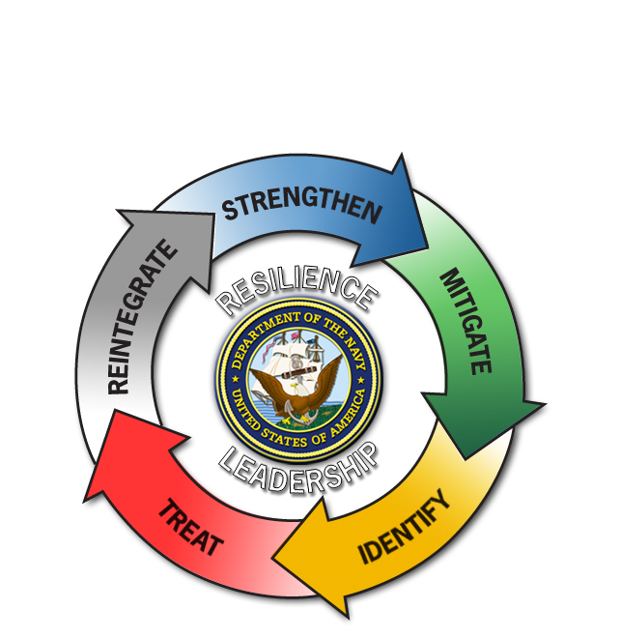

Core Leader Functions
Coast Guard Operational
Stress Control (CG -0SC )
Strengthen
Mitigate
Identify
Treat
Reintegrate
Notes:
Core Leader Functions
The CG Continuum Model by itself cannot improve psychological health of CG, or families or meet the two COSC and OSC objectives of:
Preserving force readiness
Maintaining individual health and well-being
The Core Leader Functions were developed to reinforce a leader’s commitment to Sailors, families and overall command psychological health. The following are action elements for leaders to use to manage an environment conducive to dealing with operational stress and to develop resilience:
Strengthen
Mitigate
Identify
Treat
Reintegrate
The first two functions, strengthen and mitigate, have been served by military leadership, training, and unit cohesion since long before scientific concepts of stress management were introduced to the military.
The last three leader functions of COSC and OSC — identify, treat, and reintegrate — require skills and concepts that may be newer to both military leaders and their intrinsic social and spiritual support personnel.
COSFA is designed to provide teachable and practical tools to meet these challenges for leaders to identify, treat, and reintegrate stress injuries.

Slide 6
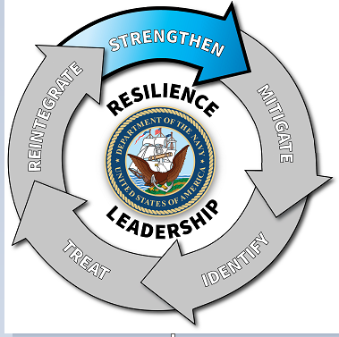
Strengthen
Coast Guard Operational
Stress Control (CG -0SC )
Strengthen against stress reactions, injuries and illnesses to successfully endure and master the stressors faced during operational deployments
Promote positive aspects and value of stress (Eustress)
An ounce of strengthening prevention is worth more than a pound of treatment and reintegration cure
Strategies:
  Instill knowledge through tough, realistic, & necessary training
  Foster unit/social cohesion
  Direct & continuous involvement of leadership to instill discipline, hardiness, courage
  Clear communication and inclusion
Notes:
Strengthen
Strengthen individuals, units, and families to enhance their resilience is the first core COSC and OSC function for military leaders. Individuals enter military service with a set of pre-existing strengths and vulnerabilities based on genetic makeup, prior life experiences, personality style, family supports, and a host of other factors.
Activities available to commanders to strengthen their personnel fall into three main categories: (1) training, (2) social cohesion, and (3) leadership. The influence leaders have over their subordinates is a sword that can cut both ways — leaders who, themselves, are in the Yellow, Orange, or Red Zones may become detriments to their units unless the leaders ‘own stress is recognized and effectively managed.
Evaluating resilience impact of training provides a tool for leaders to evaluate planned training for its impact on the resilience of unit members. The basic principles for training to promote resilience are to:
Make training as realistic as possible so that unit members will have few surprises during deployment. Intense surprise can be the worst enemy of psychological health.
Make training tough enough to push unit members to develop new skills without making it so tough they fail to master training challenges or to experience stress injuries on the training range.
Promote communication, inclusion and trust both horizontally (peer to peer) and vertically (leader to subordinate) through shared hardships and programmed success.
Social cohesion holds a group of people together, making them work together and achieve more as a unit than they would individually. Social cohesion is created in all social groups in much the same way, whether that group is a ground combat fire team, the crew of a ship, health care professionals taking care of acutely injured Marines and Sailors in a surgical hospital, or a family in the United States. Cohesion in a unit or group develops gradually through the interaction of the following factors:
Familiarity
Communication
Trust
Respect
Loyalty
Love
Great military leaders know how to develop cohesion in their units. They know how to forge attachment, trust, loyalty, and love even in a group of strangers brought together for the first time to become a team. They know how to balance shared hardship with shared recreation and insurmountable challenges with unbelievable successes.

Slide 7
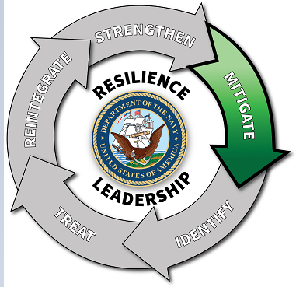
Mitigate
Coast Guard Operational
Stress Control (CG -0SC )
Mitigate stress for optimal functioning and to prevent the negative effects of stress reactions and injuries
Reduce the force & intensity of stressors experienced whenever possible
Strategies:
  Remove unnecessary stressors
  Help to balance competing priorities
  Ensure adequate sleep, rest and recreation
  Conduct After-Action Review (AAR)/debriefs in small groups after any operational or training event
Notes:
Mitigate
Since no service member is immune to stress, no matter how strong and well prepared, the prevention of stress injuries and illnesses requires continuous monitoring and alleviation of the stressors to which individuals and units are exposed.
Optimal mitigation of stress requires the balancing of competing priorities. On one side is the need to intentionally subject service members to stress in order to train and toughen them, and to accomplish assigned missions while deployed. On the other side are the imperatives to reduce or eliminate stressors that are not essential to training or mission accomplishment, and to ensure adequate sleep, rest, and restoration to allow recovery from stress between periods of challenge.
Resilience, courage, and fortitude can be likened to leaky buckets that are constantly being drained by stress. To keep them from running dry, these buckets must be frequently refilled through sleep, rest, recreation, and spiritual renewal.
Continuing this metaphor, the leader function of mitigation is crucial to preventing more holes from being punched in these leaky buckets than are absolutely necessary.
Mitigation is a preventive activity, aimed at keeping unit members in the Green Ready Zone in the face of operational challenges, and to return them to the green zone after yellow zone reactions.
Conduct After-Action Review (AAR)/debriefs in small groups .The AARs should be conducted in small groups led by their unit leaders with no outsiders present and with open and honest communication encouraged. These reviews can be helpful after any operational or training event in which there were casualties, accidents, or mistakes. The leader’s resilience-related goal in conducting an AAR following a life-threatening or challenging event is to anticipate and restore lost confidence in self, peers, leaders, equipment, and mission in order to increase feelings of safety and security in the unit. If mistakes were made, unit members need to know that the unit learned from its mistakes so they won’t be repeated.

Slide 8
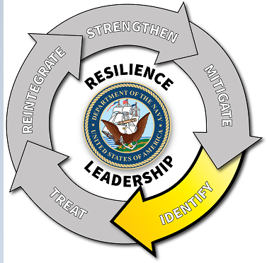
Identify
Coast Guard Operational
Stress Control (CG -0SC )
Identify and monitor the stress zones in which
individuals are operating and the stressors by which
they are being challenged
Know the individuals in your unit, including their specific strengths and weaknesses
Timely interventions to prevent small problems from
becoming big ones
Strategies: Identify, Watch and Listen for:
  Stressors encountered
  Level of distress (stress reactions)
  If functioning and performance have been degraded
Notes:
Identify
Since even the best preventive efforts cannot eliminate all stress reactions and injuries that might impact occupational functioning or health, effective COSC or OSC requires continuous monitoring of stressors and stress outcomes. Operational leaders must know the individuals in their units, including their specific strengths and weaknesses and the nature of the challenges they face both in the unit and in their home lives.
Every unit leader must know which stress zone each unit member is in at every moment, day to day, and if functioning and performance have been degraded.
Service members cannot be depended upon to recognize their own stress reactions, injuries, and illnesses, particularly while deployed to operational settings. (Stress Continuum Model)
Leaders need to trust your gut instinct when you think a service member has a stress injury. Timely interventions may prevent small problems from becoming big ones. Use the O-S-C-A-R approach to address your concerns:
Observe the behavior.
State your observation clearly
Clarify your role and why you are concerned.
Ask for clarification to understand their point of view.
Respond to individual to clarify concerns, discuss appropriate behaviors and state possible options in behavioral terms.

Slide 9
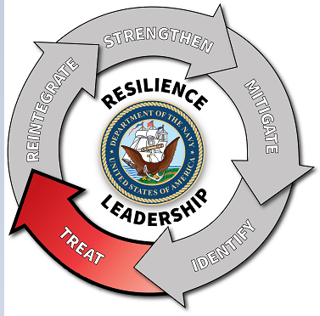
Treat (Intervene & Engage)
Coast Guard Operational
Stress Control (CG -0SC )
Treatment starts with actions taken by leaders to promote healing and hasten recovery from stress reactions, injuries and illnesses- i.e. COSFA
Ensure appropriate and timely support is delivered
  Self-care (resilience building)
  Buddy Care (peers, CRT mission)
  Chain of Command (COC)
  Chaplain
  Medical
Strategies:
  Defeat social stigma attached to asking for help within unit, medical & mental health
Notes:
Treat (Intervene & Engage)
Available tools for the treatment of stress injuries and illnesses exist along a broad spectrum, including:
Self-care (resilience building)
Buddy Care (peers, CRT mission)
Chain of Command (COC)
Chaplain
Medical
Regardless of what level or type of treatment is available and indicated for any given service member, the overall responsibility for ensuring that appropriate and timely care is delivered rests with unit leaders and their commanders. To increase the likelihood that needed care will be accepted by the individuals who need it, leaders must also attack stigma in their units and organizations, in all its forms.
Stigma can be an insurmountable barrier to admitting to someone else stress problems that have been recognized; therefore, the best and most reliable method of ensuring that everyone who needs help gets it is for small unit leaders to continually watch out for their subordinates, and for peers to watch out for each other.

Slide 10
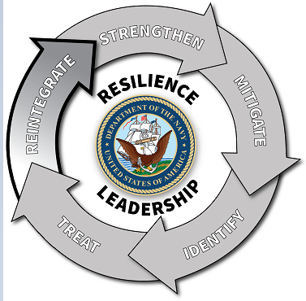
Reintegrate
Coast Guard Operational
Stress Control (CG -0SC )
Reintegrate Coasties who have been injured by stress and either have recovered or are in the process of recovering
Goals:
  Ensure psychological readiness
  Prevent unnecessary loss of personnel
  Restore a sense of honor to the wounded
  Reduce stigma associated with treatment
Strategies:
  Keep with unit if at all possible
  Expect return to full duty
  Continually address stigma
  Don't allow retribution or harassment
  Communicate with treating professionals (both ways)
Notes:
Reintegrate
Discussion Question:
-When, in what situation, and how have you seen a leader use the concepts of Core Leader Functions? Are our leaders doing what is necessary from an operational stress control perspective?
The normal course for a stress injury, as for a physical injury, is to heal over time. The vast majority heal, with or without treatment.
For stress casualties to be effectively reintegrated in their units, stigma must be continuously addressed, and the confidence of the stress-injured service member, their peers, and small unit leaders must be restored.
Operational commanders face one final challenge in the management of Service members treated for stress injuries or illnesses—to continually monitor their fitness for duty, including worldwide deployment, and mentor them back to full duty as they recover.
Stigma must be continuously addressed and the confidence of the stress-injured Marine or Sailor, peers, and small unit leaders must be restored. This process may take months since recovery from a stress injury or illness is often a slow process. In those cases in which substantial recovery and return to full duty is not anticipated, the challenge for unit commanders is to assist Service members as they transition to civilian life and Veterans Administration care.
Goals:
Ensure psychological readiness
Prevent unnecessary loss of personnel
Restore a sense of honor to the wounded
Reduce stigma associated with treatment
Strategies:
Keep with unit if at all possible
Expect return to full duty
Don't allow retribution or harassment
Communicate with treating professionals (both ways)

